Slide 1
VIRTUAL MEMORY

Slide 2
What is virtual memory?
A technique that allows the execution of processes that may not be completely in memory.
Advantage – program size > physical memory size.
Programmers need not worry about amount of physical memory available.
Not easy to implement.

Slide 3
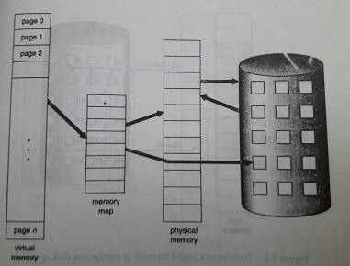
Virtual memory larger than physical memory

Slide 4
Separation of user logical memory from physical memory.
Commonly implemented by demand paging.
Lazy swapper never swaps a page into memory unless that page will be needed.
A swapper manipulates entire processes, whereas a pager is concerned with the individual pages of a process.
Decreased swap time and amount of physical memory needed.

Slide 5
To distinguish between those pages that are in memory and those pages that are on the disk, valid-invalid bit used.
When set to ‘’valid’’, it indicates that the associated page is both legal and in memory.
If set to ‘’invalid’’, indicates that the page is not valid meaning not in the logical address space of the process or is valid but is currently on the disk.

Slide 6
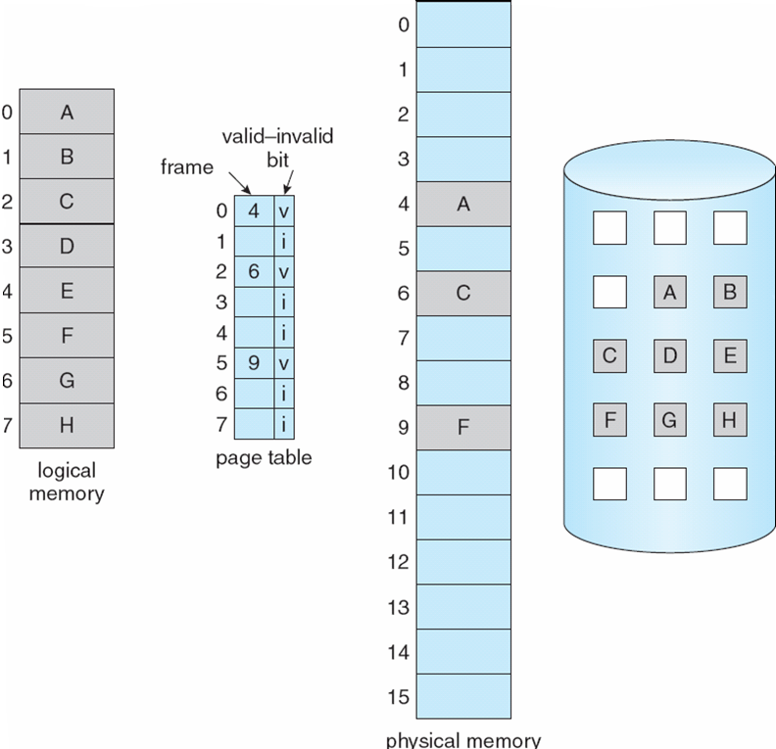
Page table when some pages are not in main memory

Slide 7

Page fault
Access to a page marked invalid causes a page-fault trap.

Slide 8
Pure demand paging – Never bring a page into memory until it is required.
To support demand paging, hardware is page table and secondary memory.
Performance of demand paging.
Effective access time for a demand-paged memory= (1-p) x ma + p x page fault time
p → probability of a page fault
ma → memory access time

Slide 9
Page-Replacement Algorithms
Page-fault rate should be lowest.
Number of frames inversely proportional to number of page faults.
Reference string – string of memory references.

Slide 10

FIFO Algorithm

Slide 11
Performance not always good.
Belady’s anomaly – page-fault rate increases as the number of allocated frames increases.

Slide 12

Optimal Algorithm(OPT or MIN)
Replace the page that will not be used for the longest period of time.
Lowest page-fault rate of all algorithms.
Difficult implementation as it requires future knowledge of the reference string.

Slide 13

Least recently used (LRU) algorithm
Replace the page that has not been used for the longest period of time.

Slide 14
A good page-replacement algorithm.
Problem – how to implement LRU replacement.
Counters – with each page-table entry, associate a time-of-use field and add to the CPU a logic clock or counter.
The clock is incremented for every memory reference.
Replace the page with the smallest time value.

Slide 15
Stack of page numbers – Whenever a page is referenced, it is removed from the stack and put on the top.
Bottom will be LRU page.

Slide 16
Allocation of frames
The user process is allocated any free frame.
There is a minimum number of frames that must be allocated and that is defined by the instruction-set architecture.
The maximum number of frames per process is defined by the amount of available physical memory.

Slide 17
Allocation algorithms
Equal allocation.
Proportional allocation (available memory is allocated to each process according to its size).
Available frames = 62, one process of size 10 pages and another of size 127 pages.
Allocation of four frames to the first and 57 frames to the other.

Slide 18
Categories of page-replacement algorithms
Global replacement
Local replacement
Problem with global replacement – a process cannot control its own page-fault rate.

Slide 19

Thrashing
High paging activity.

Slide 20
Solutions to thrashing
Local replacement.
Provide the process as many frames as it needs.
Locality – set of pages that are actively used together.
Page-fault frequency – establish lower and upper bounds on the desired page-fault rate.

Slide 21


Slide 22
Prepaging
  To reduce the large number of page faults that occur at process startup.
  Prepage all or some of the pages a process will need, before they are referenced.
  But if prepaged pages are unused, I/O and memory was wasted.

